Slide 1
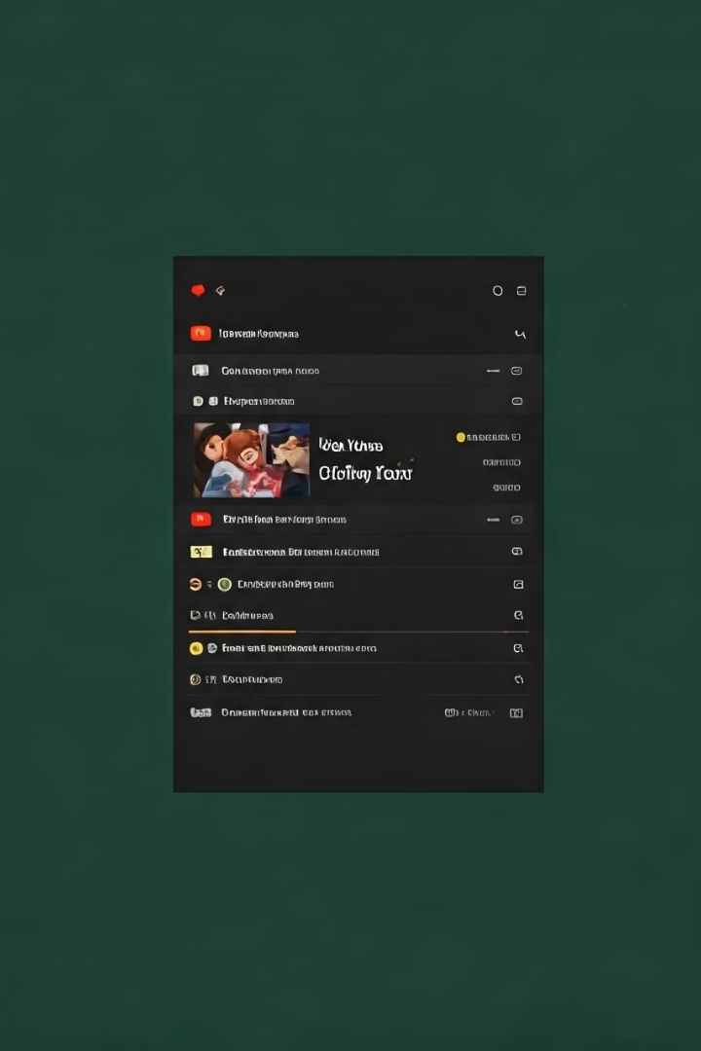
Sentiment Analysis on YouTube Comments
Presented by Binita Mahto,
Department of Mathematics & Computing, IIT (ISM) Dhanbad.
Guided by Prof. Anurag Jayswal
Notes:
1

Slide 2
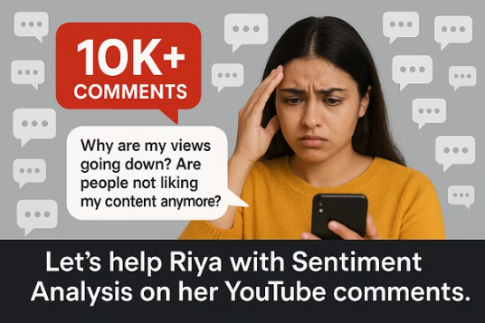
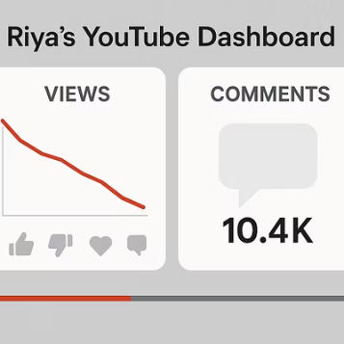
Introduction to Sentiment Analysis
Meet Riya – the YouTuber
Riya has over 1M subscribers.
Her views are dropping despite regular uploads.
She wants to understand the reason by reading comments.
But comments are too many to manually analyze.
We will help Riya using Sentiment Analysis.
Notes:
2

Slide 3
Agenda (What We’ll Cover)
1
What is Sentiment Analysis?
2
DataSet Overview
3
Data Cleaning and Preprocessing
4
EDA.
5
Feature Extraction.
6
Handling Class Imbalance.
7
Model.
8
Model Pipeline.
9
Evaluation Metrics.
10
Evaluation and Future scope.
Notes:
3

Slide 4
What is Sentiment Analysis? & Objective
What is Sentiment Analysis?
Objective
A Natural Language Processing (NLP) technique.
Build a Machine Learning model to analyze YouTube comments.
Helps to detect emotions and opinions in text (positive, negative, neutral).
Classify each comment as Positive, Neutral, or Negative.
Useful for analyzing large volumes of comments automatically.
Help creators like Riya understand audience feedback quickly and easily.
Notes:
4

Slide 5




Dataset Overview
Source
Size
Language
Labels
Kaggle dataset containing YouTube comments and sentiment labels.
Approximately 37,000 comments for training and analysis.
Code-mixed Hinglish (blend of Hindi and English text).
Comments classified as Positive, Negative, or Neutral.
Notes:
5

Slide 6


Data Cleaning & Preprocessing
"I LOVEDDDDD this Videooooo!!!! 😂😂 Follow me @username https://example.com"
"i loved this video"
Model is confused!
Model is happy!
Cleaning Steps
rim leading/trailing whitespaces .
Convert to lowercase.
Identify comments with URLs.
Identify comments with newlines.
Remove newlines from .
Retain only letters, digits, and common punctuation.
Remove stop words, keep essential ones.
Lemmatize .
Notes:
Slide Title: Data Cleaning & Preprocessing
Layout: Split the slide into two columns:
Left Column (Before Cleaning):
Add a sad AI robot illustration or emoji () at the top.
Under it, write in red color: "I LOVEDDDDD this Videooooo!!!! Follow me @username https://example.com"
Below the comment, add a small text in grey: "Model is confused!"
Right Column (After Cleaning):
Add a happy AI robot illustration or emoji () at the top.
Under it, write in green color: "i loved this video"
Below the comment, add a small text in grey: "Model is happy!"
Background: Light pink color for the left side (Before Cleaning) and light green color for the right side (After Cleaning).
Bottom of the Slide:Add a small section with bullet points titled "Cleaning Steps":
Lowercasing text
Removing punctuation, URLs, usernames
Stopword removal and lemmatization
Simplifying Hinglish with regex
Overall Style: Make the Before side look a little messy, and After side clean and organized to show transformation clearly.
6

Slide 7
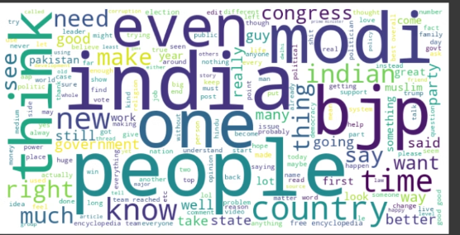
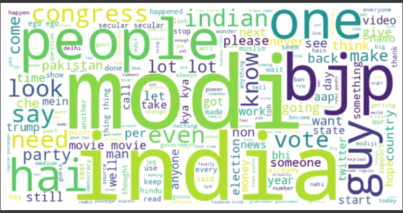
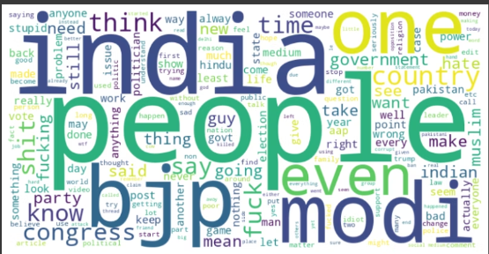
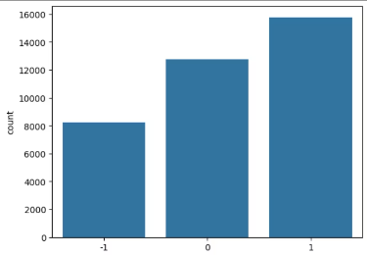
EDA (Exploratory Data Analysis)
1. Word Clouds
for positive sentiment
for neutral sentiment
for negative sentiment
2.Histogram
Here we can see the distribution is imbalance
Notes:
7

Slide 8
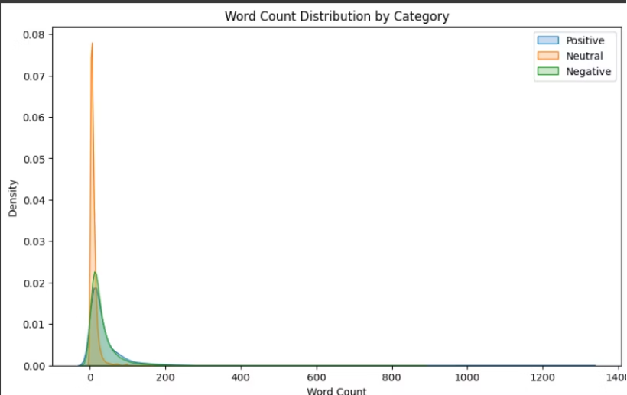
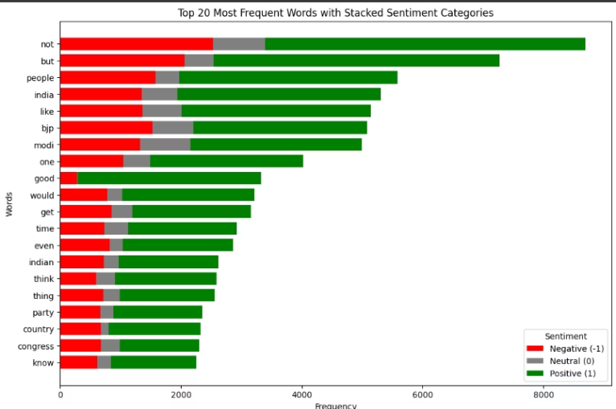
3.Kde plot
4.Stacked Bar Chart
Distribution of comment lengths across sentiments
Top frequent words vary across sentiments
Notes:
8

Slide 9
Feature Extraction (TF-IDF)
Definition
Why Choose TF-IDF?
Process Flow
TF-IDF stands for Term Frequency-Inverse Document Frequency.
Highlights key words that distinguish sentiments
Document text
Conversion to numerical matrix
It scores word importance in a document relative to a collection.
Reduces weight of common, non-informative terms
Input for machine learning model
Formula: TF-IDF(t, d) = TF(t, d) × IDF(t)
Improves model interpretability and accuracy
Term Frequency (TF): TF(t, d) = (Number of times term t appears in document d) / (Total number of terms in document d)
Inverse Document Frequency (IDF): IDF(t) = log_e(Total number of documents / Number of documents containing term t)
Notes:
9

Slide 10
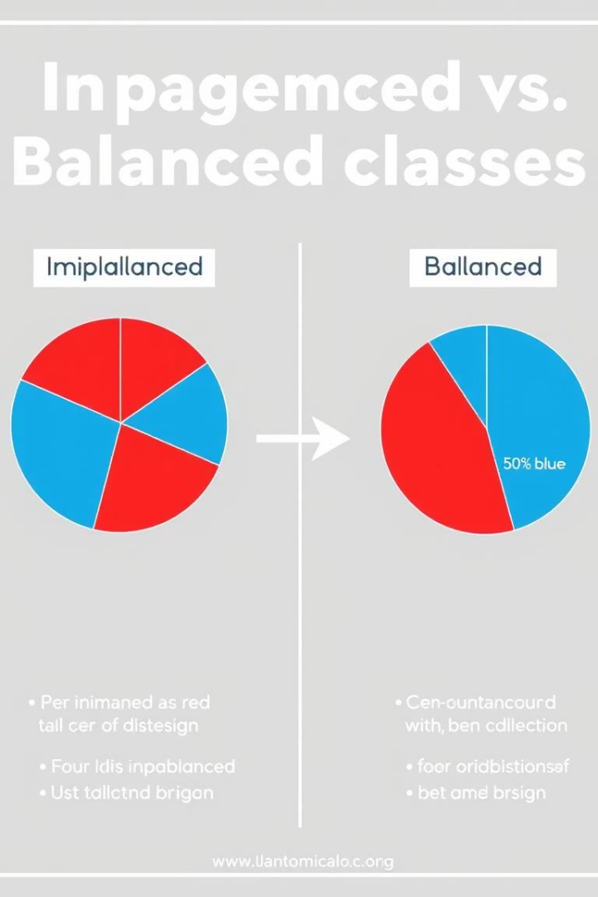
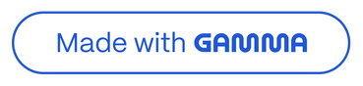
Handling Class Imbalance
Our dataset exhibits imbalance with dominant neutral comments over positive and negative ones.
Our Solution: SMOTE
Generates synthetic minority class samples for better model fairness
Prevents overfitting compared to simple oversampling
Balancing classes improves prediction accuracy and recall
Widely used and proven effective in text classification tasks
Notes:
10

Slide 11




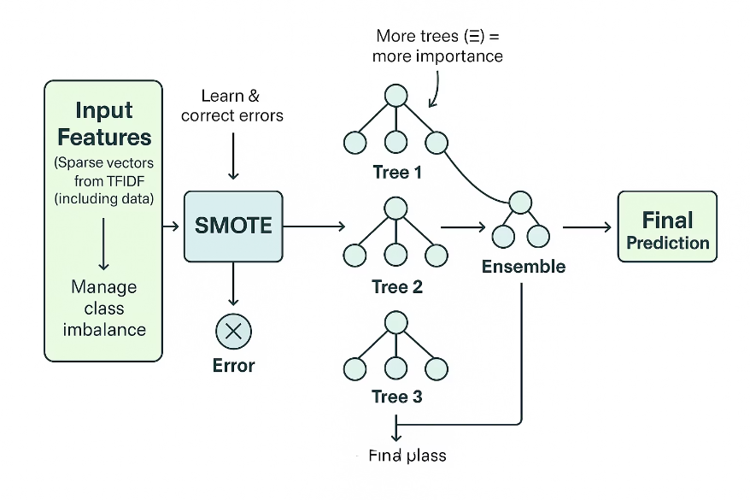
What is the Model We Used?
We selected a powerful, efficient model to handle complex patterns in text data.
Fast training
Ensemble of trees
Boosting technique
Memory efficient
Optimized for high-speed learning without sacrificing accuracy.
Combines many small decision trees to improve predictions.
Sequentially learns from errors to enhance model performance.
Uses system memory smartly for faster computation and scalability.
Notes:
11

Slide 12




Model Pipeline & Why LightGBM?
Preprocessing
TF-IDF
SMOTE
LightGBM
Clean and prepare data for analysis
Extract key features from text
Balance classes with synthetic samples
Fast, accurate, and memory efficient model
Notes:
12

Slide 13
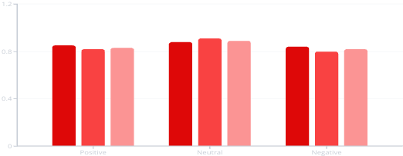
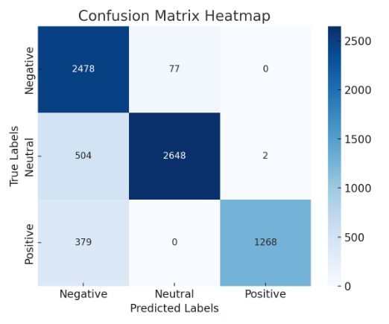
Evaluation Metrics
Accuracy = 87%
Precision
Recall
F1-Score
Performance measures by sentiment class showing model balance.
Confusion matrix heatmap visually represents prediction errors and successes.
Notes:
13

Slide 14
Application
For Content Creators
Gain audience sentiment insights
Optimize video content strategies
Engage viewers with targeted responses
Track trends in real time
Notes:
14

Slide 15

Thank You
Notes:
15

